Slide 1
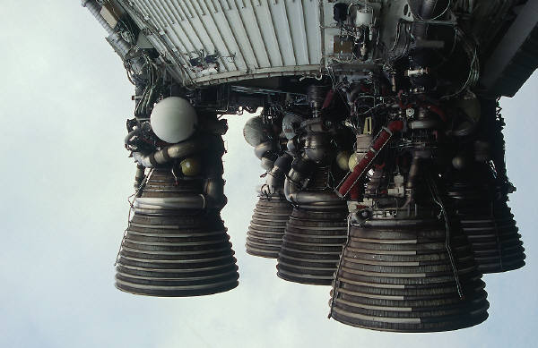
HPR Staging & Air Starting By Gary Stroick
Complex Rocket Design Considerations

Slide 2
Agenda
Tripoli Safety Code
Technical Considerations
Clusters/Air Starts
Staging
Summary

Slide 3
Tripoli Complex Project Safety Code
Complex High Power Rocket. A high power rocket that is multi-staged or propelled by a cluster of rocket motors intended for simultaneous ignition at launch or in the air.
Stability. A person intending to operate a high power rocket shall determine its stability before flight. This person shall provide documentation of the location of the center of pressure and the center of gravity of the high power rocket to the RSO if the RSO requests same.
A person shall not be closer to the launch of a high power rocket than the applicable minimum safe distance set forth in the Safe Distance Table.
Minimum Safe Distance Table
Installed Total Impulse (N-sec) | Equivalent Motor Type | Minimum Distance Commercial (feet/meter) | Minimum Distance Research (feet/meter)
160.01 – 320.00 | H | 200/61 | 250/76
320.01 – 640.00 | I | 200/61 | 250/76
640.01 – 1,280.00 | J | 200/61 | 250/76
1,280.01 – 2,560.00 | K | 300/91 | 350/96
2,560.01 – 5,120.00 | L | 500/152 | 500/152
5,120.01 – 10,240.00 | M | 1,000/305 | 1,000/305
10,240.01 – 20,480.00 | N | 1,500/457 | 1,500/457
20,480.01 – 40,960.00 | O | 2,000/610 | 2,000/610
40,960.01 – 890,000.00 | P-T | N/A | 2,500/762

Slide 4
General Technical Considerations
Motor Selection (Air Start, Cluster or Multi Stage)
Propellant Type
Avoid Hard Starting Motors (e.g. Greens)!
AeroTech
Blue Thunder
White Lightning
Cesaroni
Black pellet design permits use of all propellant types (≤54mm)
Core Size
Smaller is Better (e.g. usually implies easier starting)

Slide 5
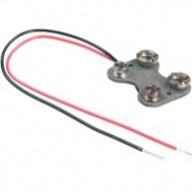
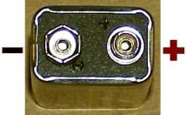
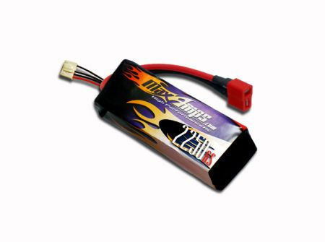
General Technical Considerations
Igniter/E-Match Selection & Wiring (Air Start or Multi Stage)
Low Amp, High Temp & Large Gas Production Igniters (E=IR)
Commercially made: 1) Oxral (5A), 2) J-Tek (9A - calculated)
Commercial kits: 1) Firestar (8.64A), 2) Magnelite (11.25A)
Battery Requirements
Igniter battery separate from altimeter
Wire igniter batteries in parallel
Ignition
Support - Wood dowel/Plastic tube/Thread
Roughing Core/Pyrogen Coat/Propellant Slivers
Research only – Head End Ignition
Premature Ignition
Battery Reversal
RF Transmissions
To shunt or not to shunt
Recommendation: Test on motors in sustainers before Air Starting or Staging
9 Volts
2 x Amperage
(1,160 mAh
for Duracell)

Slide 6
Staging
Why?
Design Considerations
Simulation Techniques
Altimeter Requirements & Programming
Launch Preparation

Slide 7
Why Stage?
Additional set of challenges at current cert. level
Multiple flight profiles
Multiple deployments
Combined and individual stability profiles
Combination of multiple motor types
Construction challenges
Sustainer/Booster coupling
Electronics driven ignition

Slide 8
What can go Wrong?
Failure Modes (non-exhaustive)
Stage ignition failure
Late stage ignition
Coupler malfunction
Early, late or no deployment
Resultant Flight Profile
Non-vertical flight (horizontal, loops, powered descent, …)
Coupler Failure Issues (Tolerance, Strength, …)
Shred
Deployment issues
Motor ignition after parachute deployment
Parachute deployment during motor burn
Zippering
Stripping parachute
Negative Altitude Records (i.e., Core Sampling )
Estimated altitude not reached

Slide 9
Staging – Design Considerations
Inline Staging (Single Sustainer)
Vertically stacked boosters and sustainer
Each booster is discarded after motor burnout
Parallel Staging (Single Sustainer)
Similar to Air Starting
Boosters are externally attached to the sustainer
Each booster separates from the sustainer after its motor burns out
Parasite Staging (Multiple Sustainers)
Similar to Air Starting
Sustainers are externally attached to the booster
Each sustainer separates after booster burn out

Slide 10


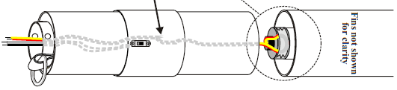
Staging – Configurations
Inline (e.g. Falcon 9)
2 or more stacked stages (usually not more than 3 stages)
Direct ignition is not feasible with APCP motors
Construction - Interstage Couplers
Rod or coupling tube design
Electronics may perform the following functions:
Ignition of next stage
Recovery deployment for prior stage
Charge separation of stages
Separation - Booster
Drag, thrust, or charge separation of stages
Upper stage ignition delays (coasting to obtain higher altitudes)
Consider igniter firing time and time for motor pressurization
Coasting too long can result in reduced altitudes, non-vertical flights, …
Recommend to start initially with no delay after booster burnout
Static/Dynamic Stability
All flight configurations must be stable which includes individual boosters, sustainer, and all design combinations
Caveat: slow subsonic boosters could tumble but may cause recovery issues
Electronics

Slide 11
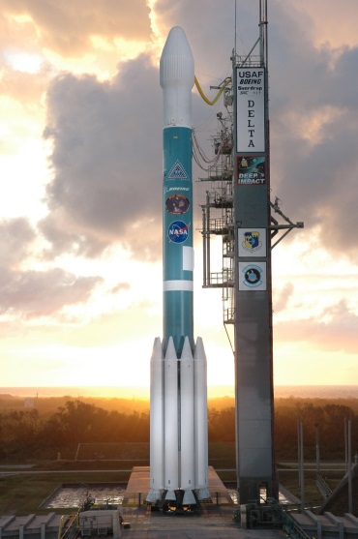
Staging – Configurations
Parallel (e.g., Delta II)
2 or more external boosters
Boosters ignited with sustainer, before, after, or any permutation
Construction - Booster Mounting to Sustainer
Aft support options
Guides with a pivot rod and notched guides on sustainer
Explosive bolts
Fore support options
Slotted booster with guides and pivot rod, sustainer hook
Explosive bolts
Electronics may perform the following functions:
Booster separation and recovery deployment
Sustainer ignition and recovery deployment
Separation - Booster
Charge or ejection separation of boosters
Separate electronics activation
Static/Dynamic Stability
Again sustainer with all booster flight configurations must be stable
Angle boosters through CG when possible
Sustainer
Booster

Slide 12
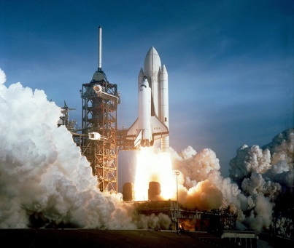
Staging – Configurations
Parasite (e.g., Space Shuttle kind of)
2 or more sustainers
Sustainers ignited after booster burn out
Construction – Sustainer mounting to booster
Aft support option
Booster has notched supports for sustainer fins
Fore support option
Booster fitting for sustainer launch lug or rail guide
Electronics may perform the following functions:
Sustainer ignition, separation and recovery deployment
Booster recovery deployment
Separation - Sustainer
Thrust or charge separation
Static/Dynamic Stability
Again booster with all sustainer flight configurations must be stable

Slide 13
Staging – Simulation Techniques (Rocksim v9.1.1)
‘Rocket design attributes’ tab
Set ‘Number of stages:’ field (default is one)
Use one for Parallel or Parasite designs
Use two or more for Inline designs
‘Rocket design components’ tab
Components
Sustainer (Uppermost stage)
Inline
Booster or Booster 1 (1st stage)
Booster 2 (2nd stage)
Design and build each stage
There must be at least one motor mount per stage
Parallel & Parasite
Add one Pod per Booster/Sustainer, name each booster group, leave ejected during simulations box checked, and set radial position
Select Pod and build Booster/Sustainer with a motor mount

Slide 14
Staging – Simulation Techniques (Rocksim v9.1.1)
Load Motors using ‘Prepare to Launch’ dialog box ‘Engine Selection’ tab
Inline Simulation
Load motors with appropriate Ignition Delay (coast time)
Booster motors must have a non-negative numeric Ejection Delay value to stage (Stage Separation Time)
All motors will be ignited in stage sequence
Parallel Simulation
Load Booster & Sustainer motors with appropriate Ejection and Ignition Delays
Use identical Ejection Delay times for all motors that are Boosting simultaneously
Booster separation occurs based on Ejection Delay (must have a non-negative numeric value)
All Ignition Delay times are measured from 1st ignition (e.g., no tie to pods)
Parasite Simulation (limited to one sustainer only!)
Load Booster and Sustainer motors with appropriate Ejection and Ignition Delays
Booster separation occurs based on Ejection Delay (must have a non-negative numeric value)
All ignition delay times are measured from 1st ignition (e.g., no tie to pods)

Slide 15
Staging – Altimeter Requirements
Minimum
Preferred
Timer(s)
Pyro channel control based on:
Multiple Timed Delays
Two or more pyro channels
Accelerometer with timer
Pyro channel control based on:
Deceleration Detection
Timed Delay
Recognition of Multiple Deceleration Events
Barometer (for dual deployment of main)
Two or more pyro channels
Tilt Detection

Slide 16
Staging – Altimeter Programming
Detect Liftoff
For Each Stage X
Do
If Barometric Pressure Increasing or Vertical Velocity < 0 or Tilt > 10° then go to Deployment
Until Decelerating Vertically And End of Stage X Time Delay
Fire Stage X Igniter(s)
Next Stage
Deployment
Wait Until Apogee Detected And End of Apogee Time Delay
Fire Drogue/Main E-Match(es)

Slide 17

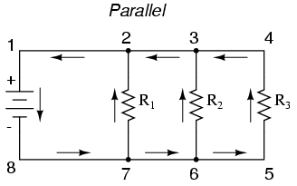
Staging – Launch Preparations
Igniters
Always wire in Parallel
Consider dipping in pyrogen
Solid Fuel Motors
Roughen top grain core
Lightly coat top grain core with pyrogen

Slide 18
Staging Summary
DO’s
Don’ts
Simulate your flight (all configurations)
Learn your altimeter and programming alternatives
Augment igniters and/or motors
Cant motor mounts through CG (if possible)
Use robust coupling and separation methods
Separate batteries for igniters and altimeters
Use hard starting motors or large core motors in sustainers
Wire igniters/e-matches in series
Use high amperage igniters

Slide 19
Cluster/Air Starting
Why?
Design Considerations
Simulation Techniques
Altimeter Requirements & Programming
Launch Preparation

Slide 20
Why Cluster or Air Start?
Cluster
Additional set of challenges at current cert. level
Igniting multiple motors simultaneously
Combining multiple motor types
Centering rings & motor mounts
Air Start
All of the above plus
Electronics driven ignitions
Combine motors and delays for adjustable flight profile

Slide 21
What can go Wrong?
Asymmetrical Thrust
One or more motors do not ignite
One or more motors ignite late
Resultant Flight Profile
Non-vertical flight (angled flight, loops, …)
Unstable due to inadequate thrust (wind cocking)
Deployment issues
Late (if motor ejection is used)
Zippering
Stripping parachute
Estimated altitude not reached

Slide 22
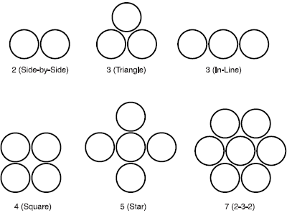
Clustering/Air Starting – Design Considerations
Inline geometries will always require the largest diameter airframe
Motor Mounting
Alignments
Axially Parallel
Unstable under Asymmetrical Thrust
Angled through Center of Gravity
Stable under Asymmetrical Thrust
Motor Retention
Spacing between mounts
Layout Options
Geometries must be balanced
Heterogeneous mount sizes

Slide 23
Clustering/Air Starting - Geometries
Side by Side – Requires identical motors
Not an option for Air Starting
Alternatives
Triangle – Also requires identical motors and not an Air Starting option
Inline – Outside motors must be identical may be used for Air Starting
Square – Motors opposite of center must be identical
Up to two motor types may be used
Up to one air start is possible
Star – Opposite motors must be identical
Up to three motor types may be used
Up to two air starts are possible
Hexagon – Opposite motors must be identical
Six motor configuration (There is also a Rectangle Configuration)
Up to three motor types may be used
Up to two air starts are possible
Seven motor configuration
Up to four motor types may be used
Up to three air starts are possible

Slide 24
Clustering/Air Starting – Simulation Techniques (Rocksim v9.1.1)
Parallel Motor Mounts
Add an Inside Tube, name it and mark as motor mount
Add other components to the motor mount (engine block, …)
If more motor tubes of this type are needed select Cluster
For uniform mounts select the appropriate pattern and follow the Wizard instructions
For non-uniform mounts select “User tube count & radius” option and follow the Wizard instructions
Select a motor mount and add a centering ring
The necessary holes are automatically added
Copy the centering ring and reposition as many times as needed
Canted motor mounts cannot be simulated
Copy needed motor files
Reduce thrust curve using cosine of motor mount angle

Slide 25
Clustering/Air Starting – Simulation Techniques (Rocksim v9.1.1)
Load Motors using ‘Prepare to Launch’ dialog box ‘Engine Selection’ tab
Cluster Simulation
Load motors with no Ignition Delay
All motors will be ignited simultaneously
Air Start Simulation
Load motors with Ignition Delays (type value then must hit <enter key> - Rocksim quirk)
Use identical Ignition Delay times for all motors that are Air Started simultaneously
Use different Ignition Delay times for each set of Air Starts
All Ignition Delay times are measured from 1st ignition

Slide 26
Air Starting – Altimeter Requirements
Minimum
Preferred
Timer(s)
Pyro channel control based on:
Multiple Timed Delays
Two or more pyro channels
Accelerometer with timer
Pyro channel control based on:
Deceleration Detection
Timed Delay
Recognition of Multiple Deceleration Events
Barometer (for dual deployment of main)
Two or more pyro channels
Tilt Detection

Slide 27
Clustering/Air Starting – Altimeter Programming
Detect Liftoff
For Each Air Start X
Do
If Barometric Pressure Increasing or Vertical Velocity < 0 or Tilt > 10° then go to Deployment
Until Decelerating Vertically And End of Air Start X Time Delay
Fire Air Start X Igniter(s)
Next Air Start
Deployment
Wait Until Apogee Detected And End of Apogee Time Delay
Fire Drogue/Main E-Match(es)

Slide 28
Clustering/Air Starting – Launch Preparations
Igniters
Always wire in Parallel
Protect wires with Aluminum Tape
Consider dipping in pyrogen
Solid Fuel Motors
Roughen top grain core
Lightly coat top grain core with pyrogen
Motor Mounts
Cover empty mounts with Aluminum Tape

Slide 29
Clustering/Air Starting Summary
Do’s
Don’ts
Protect igniter wiring
Design for motor retention
Cant motor mounts through CG
Simulate your flight
Learn your altimeter and programming alternatives
Augment igniters and/or motors
Separate batteries for igniters and altimeters
Use hard starting motors or large core motors
Wire igniters/e-matches in series
Use high amperage igniters

Slide 30
Summary
Many aspects of Air Starting and Staging are similar
Altimeter selection & programming
Some design elements
Motor and igniter preparation
Clustering, Air Starting & Staging provide new construction, electronics, and motor challenges at your current certification level
Combine all three for even greater challenges

